Slide 1


SPFx - DI
Dependency Injection in SPFx

Slide 2
Dependency Injection (DI)
DI is a set of practices that allow to build loosely coupled applications

Slide 3
Dependency Injection (DI)
DI is a set of practices that allow to build loosely coupled applications
It´s NOT
- A library
- A framework
- A tool
It IS
- A way of thinking
- A way of designing code
- General guidelines

Slide 4
Dependency Injection (DI)
DI is a set of practices that allow to build loosely coupled applications
Small Components…
- Independent
- Reusable
- Interchangeable
... plugged together to form a bigger application
Benefits
- Small classes with single responsibility.
- Easier maintenance
- Extensibility
- Testable

Slide 5
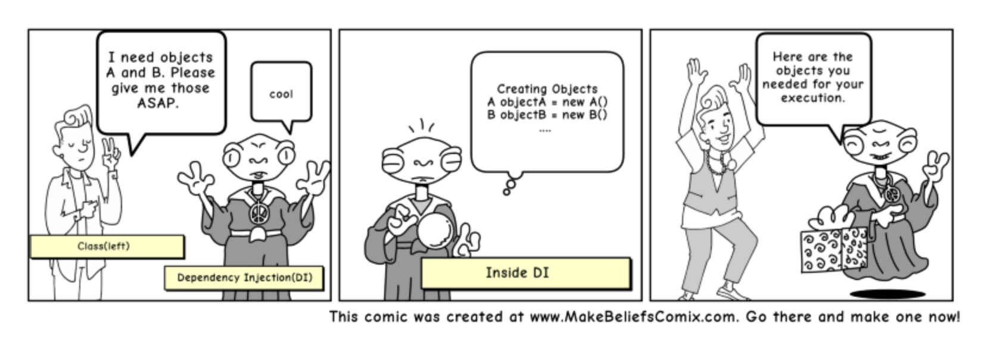
Dependency Injection (DI)

Slide 6
DI in SPFx
sp-core-library
- Service Key: Lookup key, used to fetch a dependency.
- Service Scope: Service locator pattern.
* consume: Consumes a service from a service scope
* startNewChild: Constructs a new service scope that is a child of the current scope.
* createDefaultAndProvide: Constructs the default implementation of the specified service key and registers it.
* finish: Completes the initialization sequence for a service scope.

Slide 7

DI in SPFx : Basic Demo

Slide 8
DI in SPFx : Tasks Demo
MyTasks Webpart
GraphTaskService
ConsoleLogger

Slide 9
DI in SPFx : Tasks Demo
MyTasks Webpart
ITaskService
GraphTaskService
MockTaskService
ILogger
AppInsightsLogger
ConsoleLogger

Slide 10
Thank you!

